Slide 1
Testing Colored gel effect on light levels
Liam Fieggen and Fan Han Hoon

Slide 2
Materials
From Arduino Student Kit:
1 x 10kΩ Resistor (±5% tolerance)
1 x Phototransistor (Supply Voltage 3-5 V) (Spectrum sensitivity 480nm-1050nm)
1 x Dimmable Flashlight (250 Lumens)
1 x Light Bulb (60-Watt Equivalent B11 Dimmable)
5 x Colored Gels ( Red, White, Yellow, Green, Blue)
Arduino Uno Breadboard
Jumper wires

Slide 3
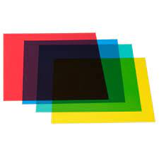
Hypothesis
There is a significant difference in the light that passes through different colored gels
Different colored gels allow different degree of light intensity to pass through.

Slide 4
Hypothesis test
Null Hypothesis:
Different colored gels will absorb and block off the same degree of light intensity that passes through and result in the phototransistor having same resistance value.
Alternating Hypothesis:
Different colored gels will absorb and block off different degree of light intensity that passes through and result in the phototransistor having different readings on resistance.

Slide 5
Experimental setup
Light source
photoresistor

Slide 6
Experimental setup
Colored gel

Slide 7
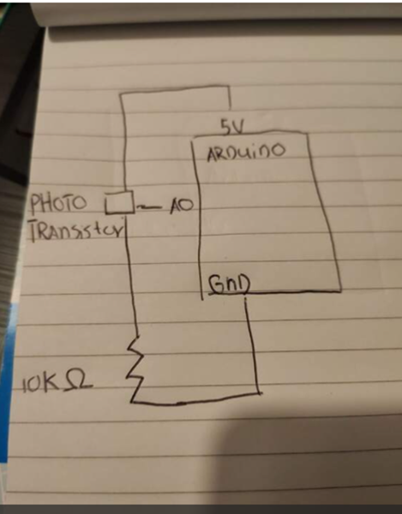
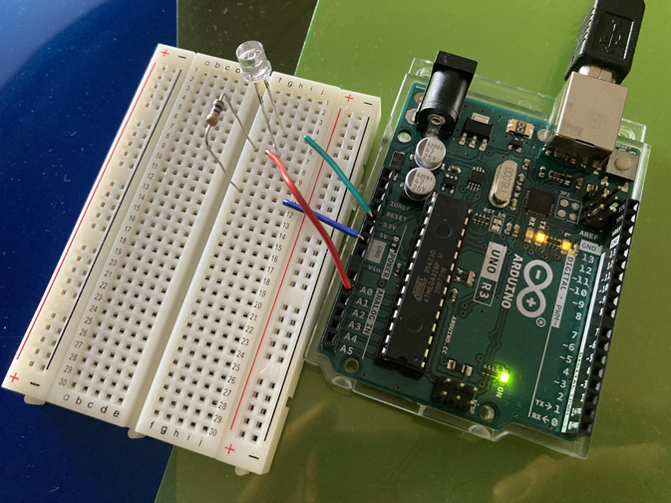
Experimental Setup

Slide 8
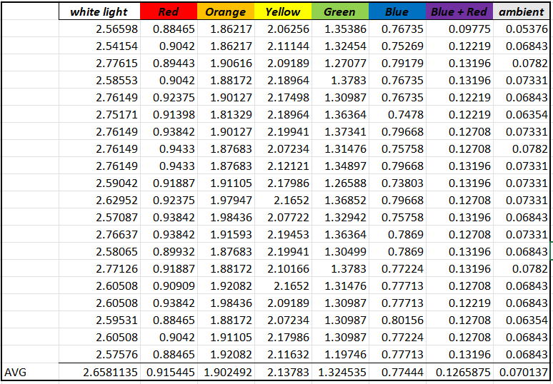
Experimental data

Slide 9
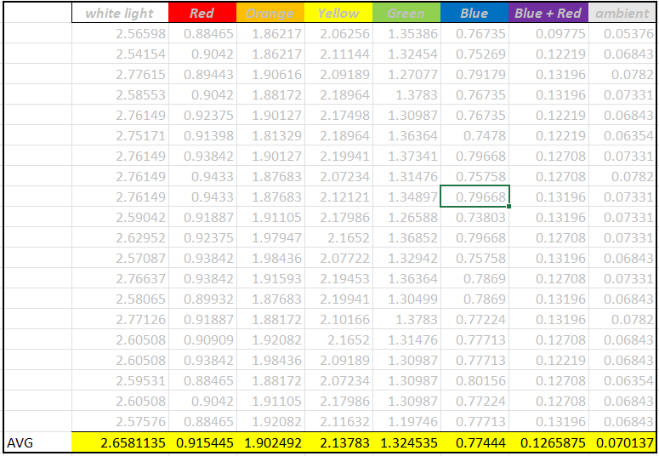
Experimental data

Slide 10
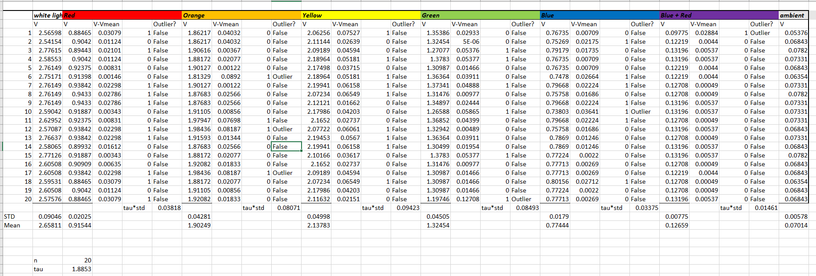
Outlier

Slide 11
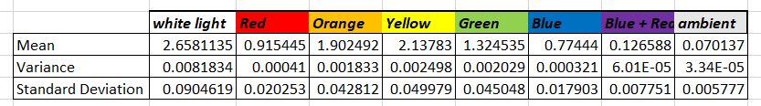
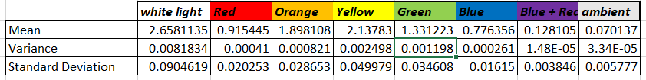
Basic analysis of the data
With Outlier
With Outlier
Without Outlier

Slide 12
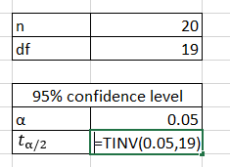
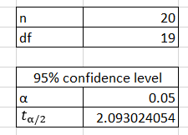
Setup for student’s PDF

Slide 13
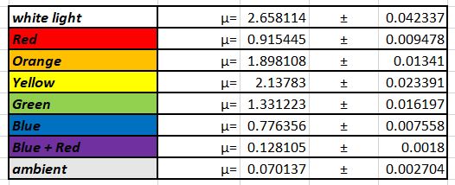
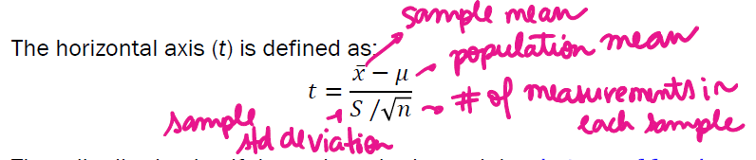
Population Mean

Slide 14
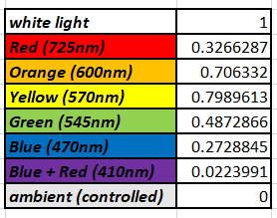
Normalized data

Slide 15
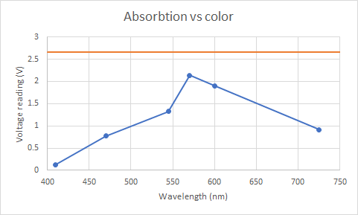
Absorption spectrum of gels
White light
Color gels

Slide 16
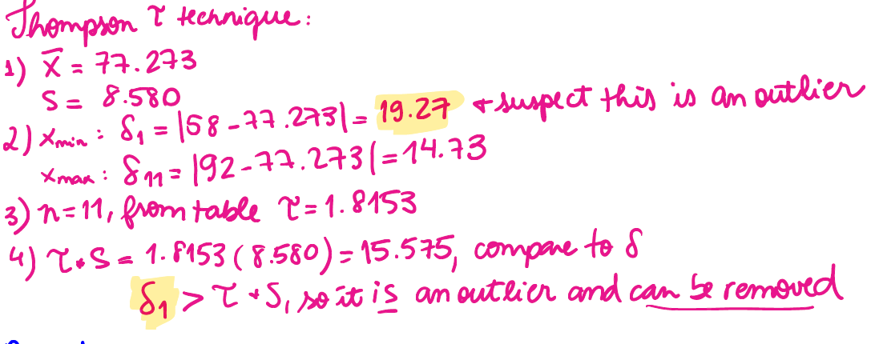
Outlier

Slide 17
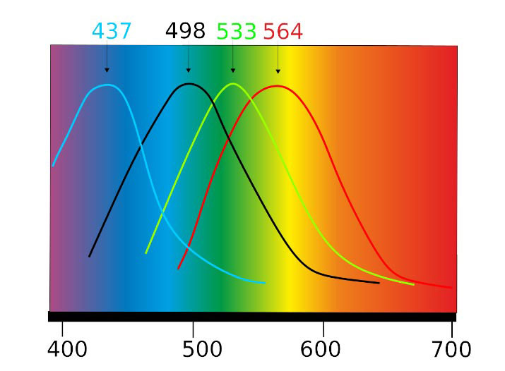
Absorption spectrum of human eye

Slide 18
Hypothesis Test Results
Different colored gels restricted the light exposure to the phototransistor and caused the fluctuations of the voltage measured due to the changes in resistance.
The p-value for the null hypothesis was proven to be 0. None of the color cases have shown equal or close value in the measured data.

Slide 19
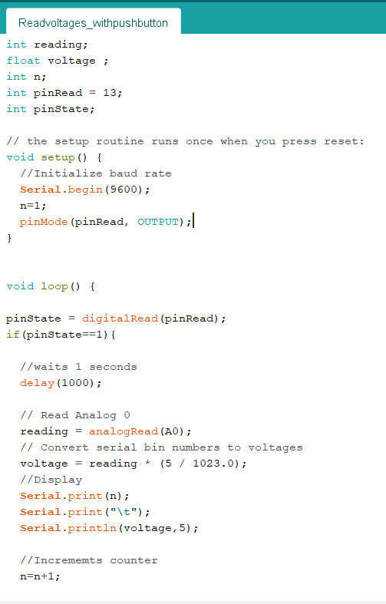
Experimental code

